Slide 1

K. K. Wagh Polytechnic, Nashik. Hirabai Haridas Vidyanagari, Amrutdham, Panchavati, Nashik-422003 Department of Computer Technology
‘‘
A Holistic Approach to Campus Recruitment and Student Profile Analysis for Placement
”
Guide name: Mr. S. H. Sangale
Group Members:
Kalyani Hemant Bangar
Aditya Arun Dhakane
Shraddha Punjaram Gaidhani
Ashwini Ashok Salunke
CP- 04

Slide 2
CONTENTS
Introduction
Principle of Project
Functional Requirements
Project Design
Working of Modules
Results of Project
Testing
Costing
Application
Advantage and Disadvantage
Future Enhancement
References

Slide 3
INTRODUCTION
The system is introduced to bridge the gap between education and the job market. It addresses challenges faced by students and employers during the transition from academic to the professional world.
The system uses data-driven analysis to create student profiles, helping students understand their strengths And employers identify suitable candidates efficiently.
It takes a holistic approach to recruitment, and placement emphasizing practical skills and industry readiness.
This system signifies a commitment to job-ready graduates and fostering collaboration among students, institutions, and employers.

Slide 4
PRINCIPLE OF PROJECT
Data-driven analysis: Utilizing data to create student profiles and help employers identify suitable candidates efficiently.
Holistic approach: Emphasizing practical skills and industry readiness in recruitment and placement, considering not only academic performance but also extracurricular involvement, soft skills, and career aspirations.
Comprehensive profile evaluation: Assessing candidates based on a range of criteria beyond academic achievements to ensure a more inclusive and effective recruitment process.
Proactive engagement: Encouraging active involvement of students, institutions, and employers in the recruitment process to foster collaboration and better outcomes.

Slide 5
Project Functional Requirements
Sr. no | Functions | Input | Process | Output
1 | Candidate Registration | Candidate detail (name, email, password) | Verify and store information | Confirmation message, Candidate profile
2 | Company Registration | Company details ( name, email, password) | Verify and store company information | Confirmation message, Company profile
3 | Company job posting | Job related details | Post job listing to the platform. | Post job list
4 | Job matching | Candidate profile, job requirements | Match candidate to job opening based on skills and criteria. | List of matching job opening.

Slide 6
Project Functional Requirements
Sr. no | Functions | Input | Process | Output
5 | Skill assessment | Candidate skills test | Evaluate candidate skills based on assessment | Skill assessment result
6 | Submit job application and track status | Job application details | Store application to the candidate and posting. Display the status of job application (received, in progress, waiting, rejected) | Confirmation of application submission. Status of application

Slide 7
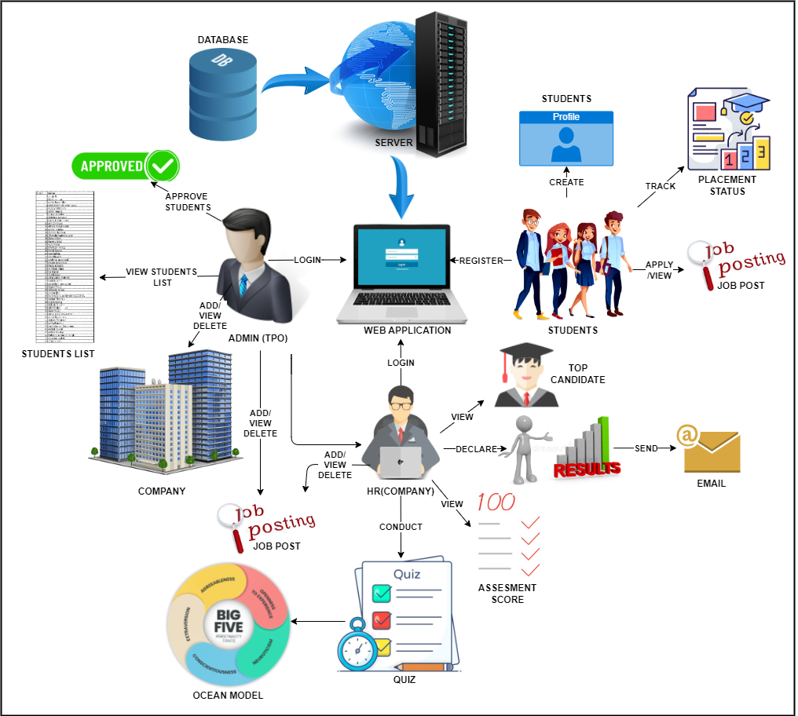
Project Design
Fig.1 System Architecture

Slide 8
Project Design
Key features of the Core System include:
User Profiles, Job Posting, Assessments, Notifications, Data Management, Security, Reporting and Analytics
Teacher (TPO): Can create and manage student profiles, post job-related information, communicate with students for guidance and feedback, access analytics and reports related to student performance and job placement.
Student: Can create detailed profiles, access job listings, apply for jobs, track application statuses, receive updates on application statuses and interview invitations, optionally take assessments, and quizzes to showcase skills.
HR Personnel: The module facilitates company profile management, job posting, student application review, communication with students/teachers, and feedback provision on usability and candidate quality.

Slide 9
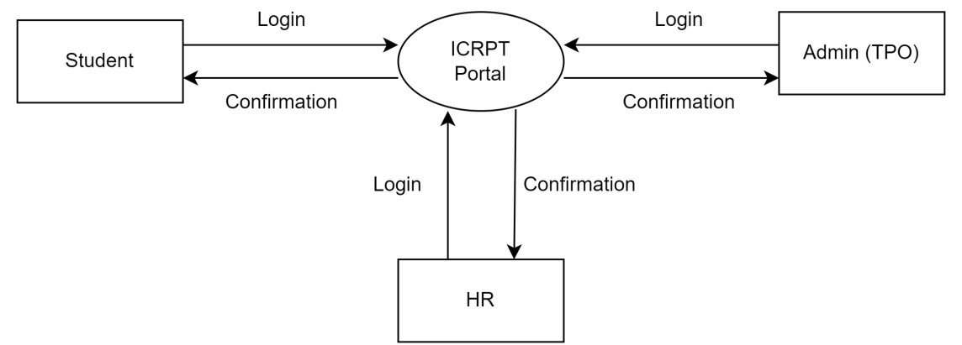
Dfd diagram
A Data Flow Diagram (DFD) is a graphical representation of how data flows within a system.
In the context of a Training and Placement System, the DFD diagram illustrate how data moves within the system to manage the training and placement processes.
FD-0 displays a simplified high-level process diagram showing the login interactions between students, an admin (TPO), an HR to the ICRPT system
DFD-LEVEL: 0

Slide 10
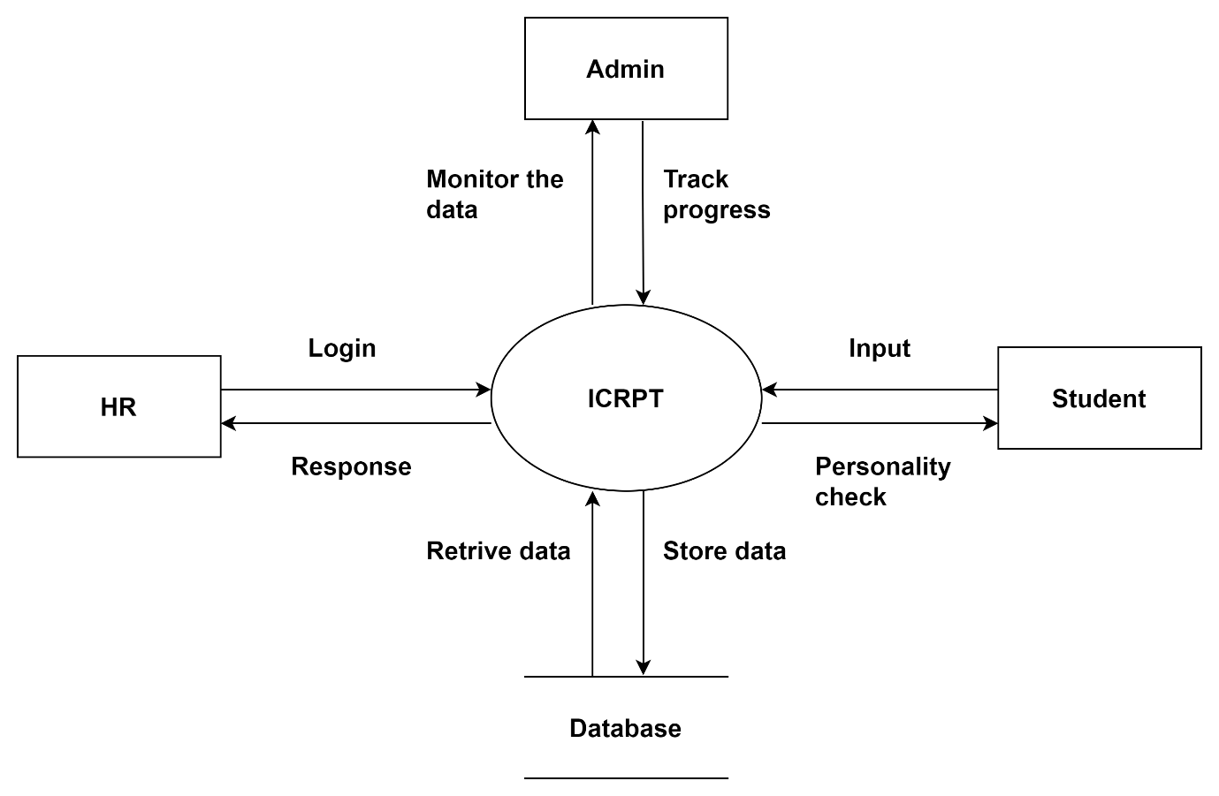
DFD-LEVEL: 1

Slide 11
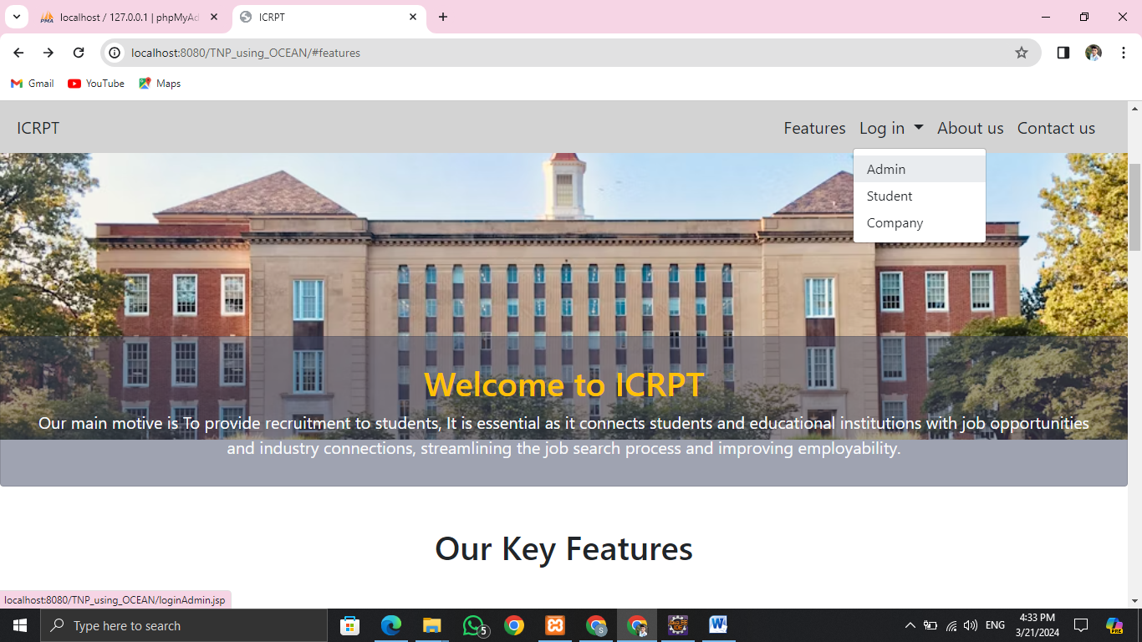
Working of module
Home Page
Main Module in the system:
Admin (TPO)
Student
Company (HR)

Slide 12
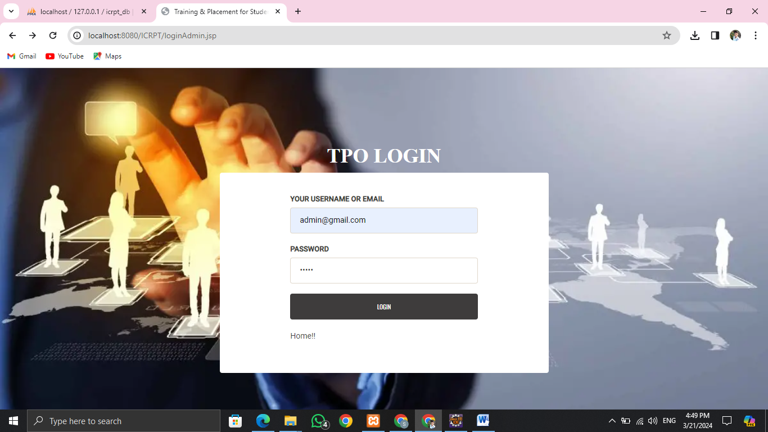
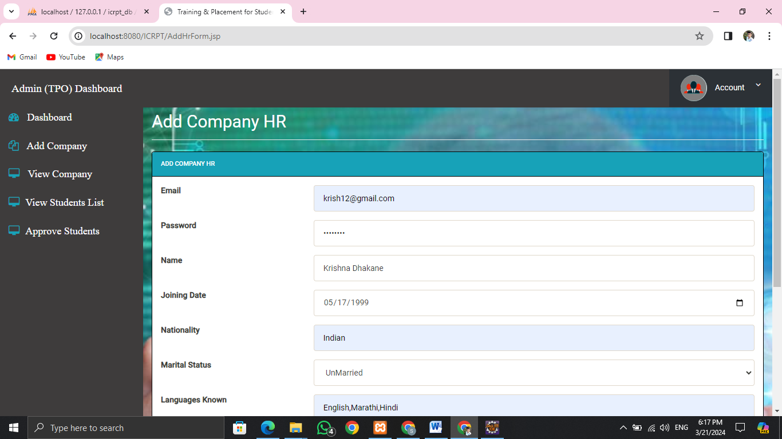
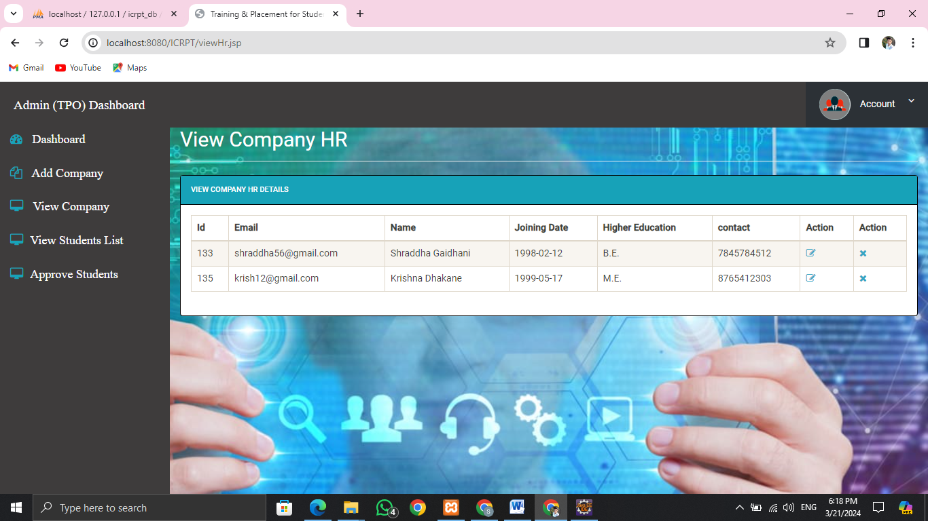
Working of Module: Admin (TPO)
TPO Login
Add Company
View Company list which are available

Slide 13
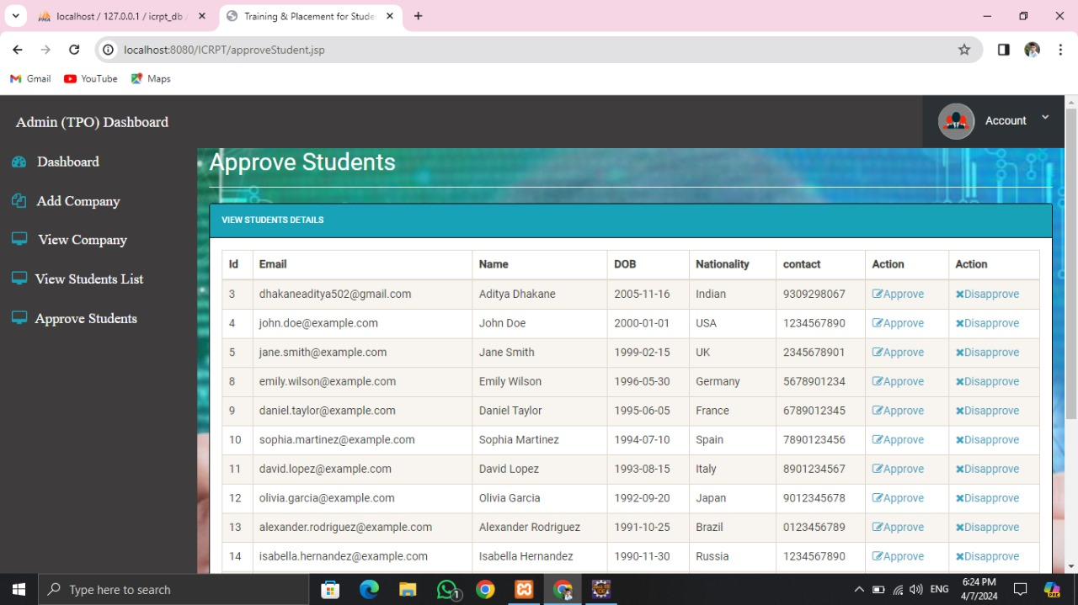
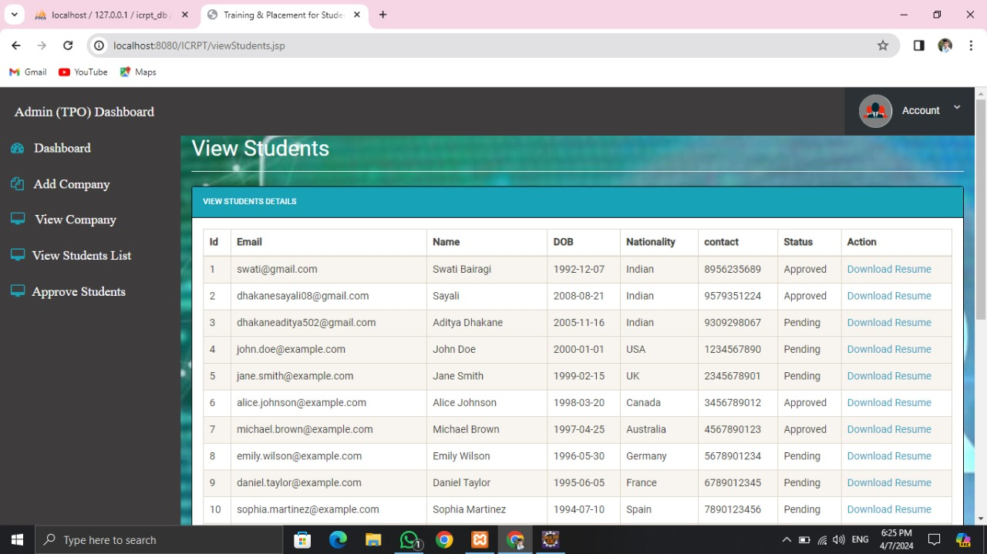
Working of Modules: Admin (TPO)
List of all Students interested in ICRPT
Student list to whether to Approve them or not

Slide 14
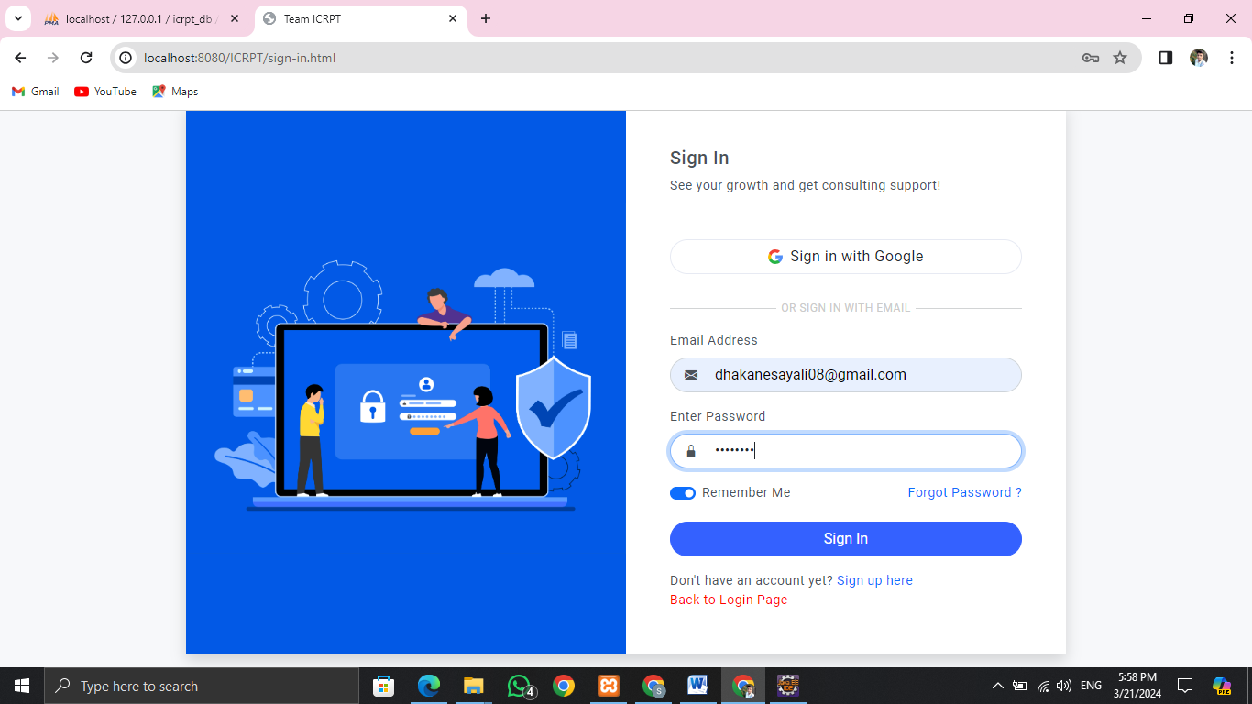
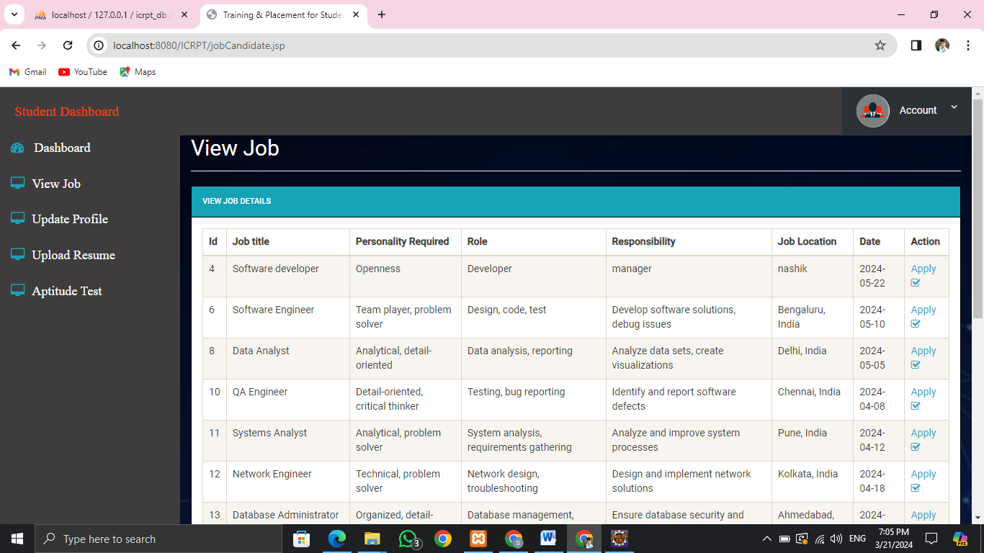
Working of Module: Student
Sign-In page which will redirect to student dashboard if the student is approved
View Jobs which are currently active

Slide 15
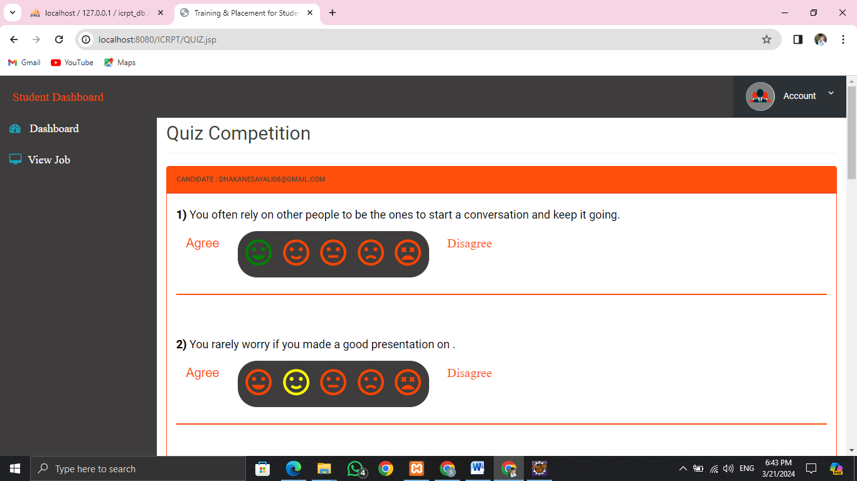
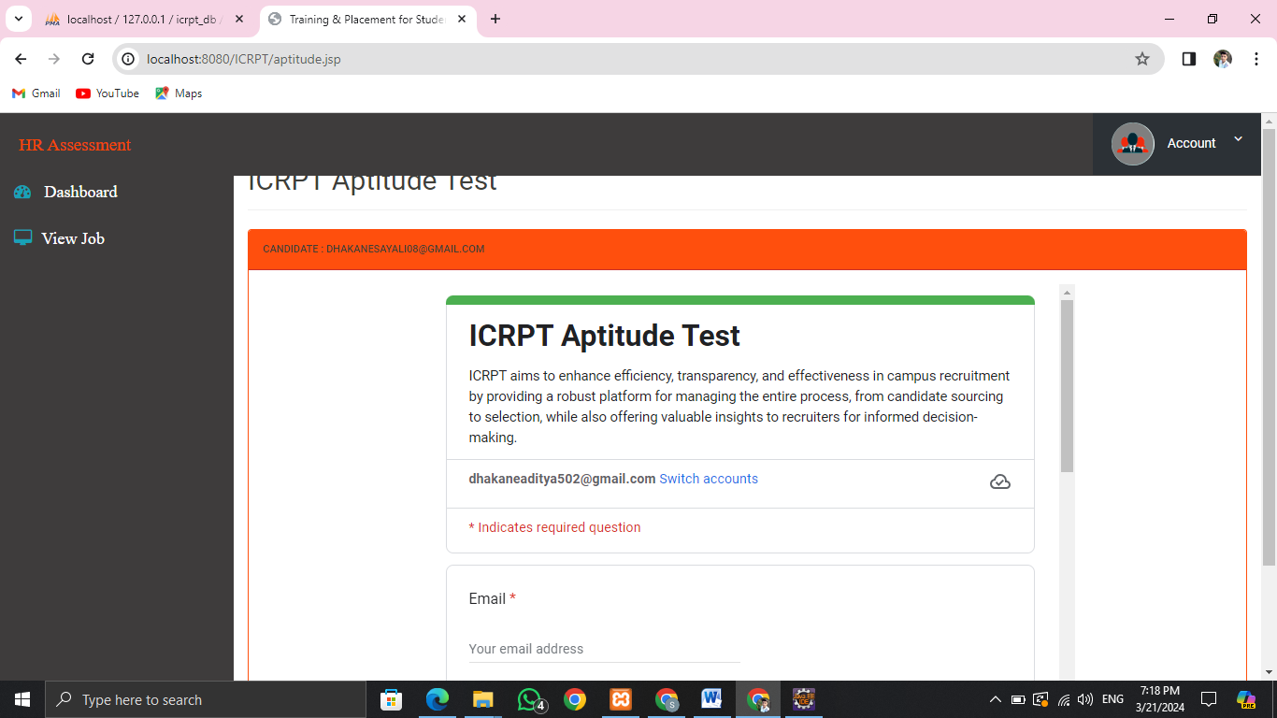
Working of Module: Student
When you apply for the job it will redirect to the Quiz
Based on the 5 big factor (10 question)
Result will be generated based on the 5 factors
Sample Aptitude test for Logical reasoning
For the Practice Purpose

Slide 16
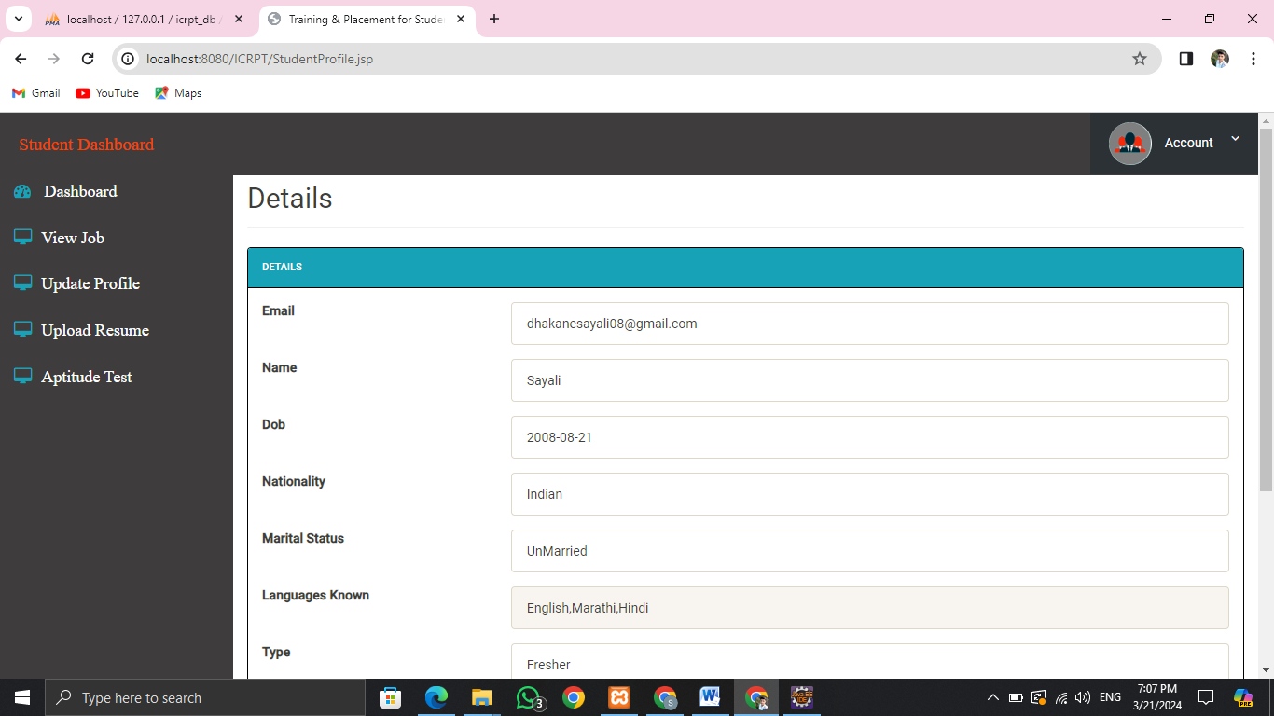
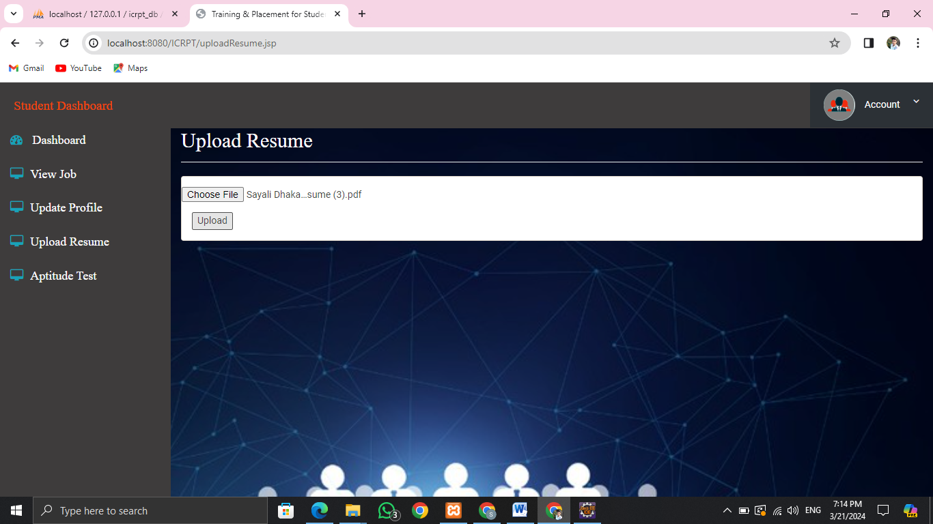
Working of Module: Student
To Update profile
Upload Resume as it is the main factor

Slide 17

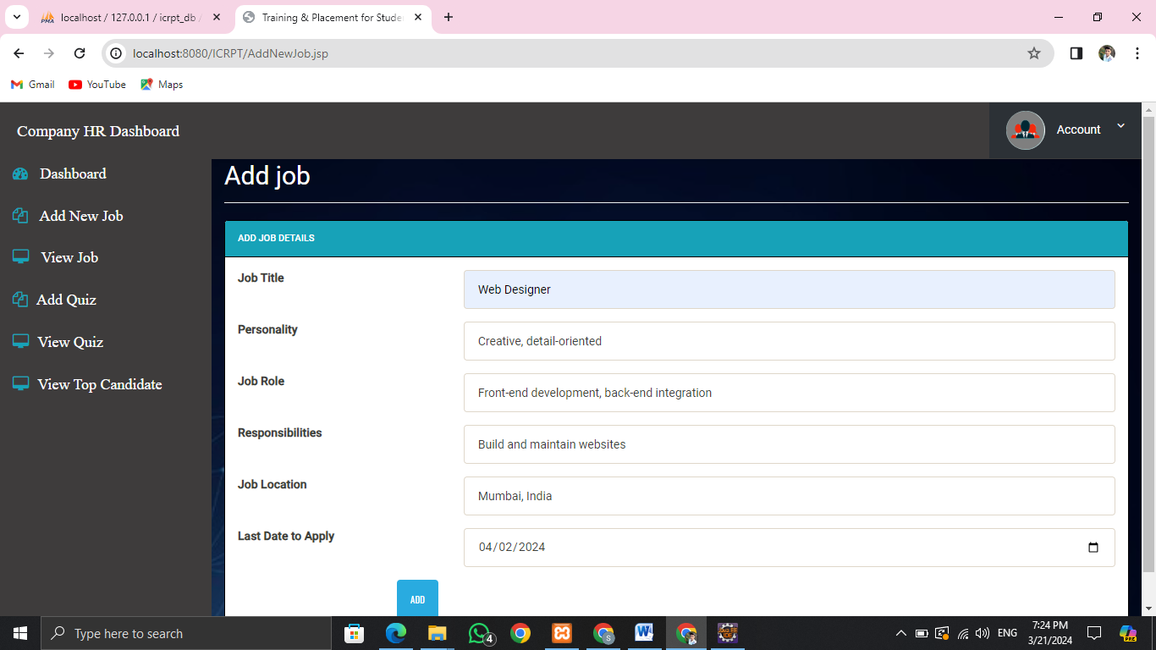
Working of Module: Company(HR)
HR Login
The HR will add Job Post and Enter the details for the Requirements of the Job

Slide 18


Working of Module: Company(HR)
View Jobs Which are posted by the Company
Add Quiz Based on the personality required for the Job

Slide 19
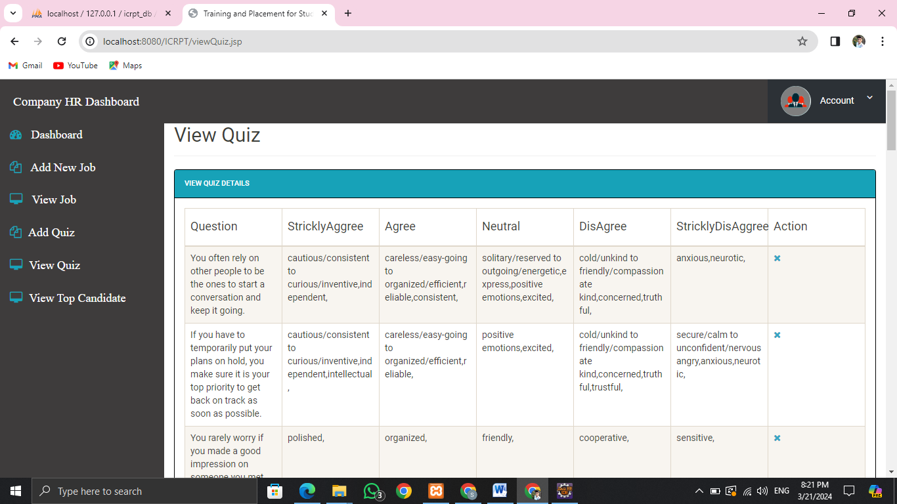
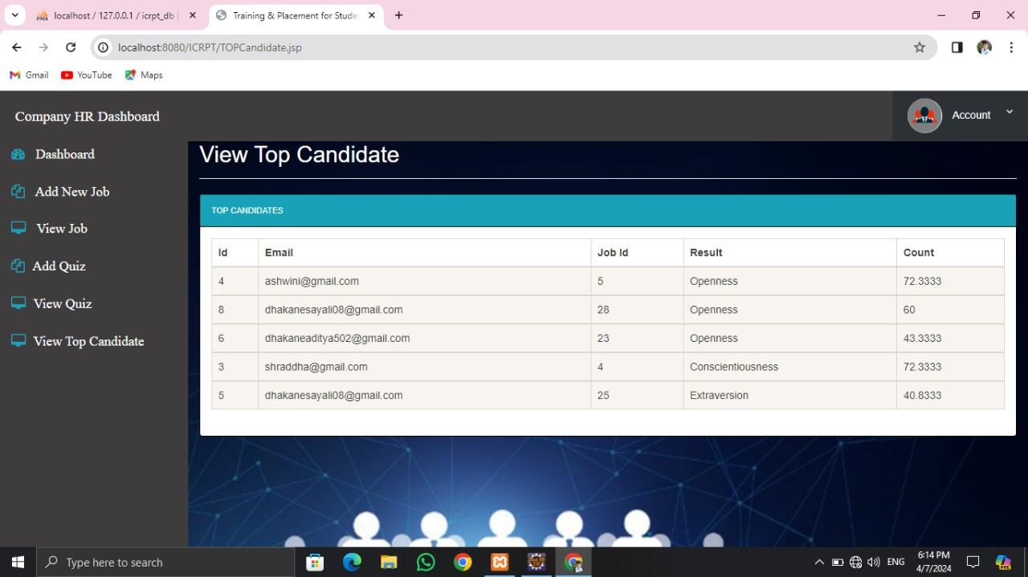
Working of Module: Company(HR)
Can View the design and structure of the Quiz which were added
Can View the Top Candidates and then the Top Candidates will only receive the Email

Slide 20
Unit Testing: Admin module
Test Case ID | Test Description | Input Data | Expected Result | Actual Result | Status | Comments
TC_ADM_001 | Verify login with approval by admin | Valid username, valid password | Admin successfully logged in | Admin successfully logged in | Pass | Test Performed Successfully
TC_ADM_002 | Verify login with blank username and password | Blank username and password | Login failed with appropriate error message | Login failed with appropriate error message | Pass | Test Performed Successfully
TC_ADM_003 | Verify view students profile functionality | - | List of students' profiles displayed | List of students' profiles displayed | Pass | Test Performed Successfully
TC_ADM_004 | Verify view HR profile functionality | - | List of HR profiles displayed | List of HR profiles displayed | Pass | Test Performed Successfully
TC_ADM_005 | Verify add job functionality | Valid job details | Job added successfully | Job added successfully | Pass | Test Performed Successfully
TC_ADM_006 | Verify view job functionality | - | List of available jobs displayed | List of available jobs displayed | Pass | Test Performed Successfully
TC_ADM_007 | Verify view top candidates functionality | - | Top candidates displayed with result count | Top candidates displayed with result count | Pass | Test Performed Successfully
TC_ADM_008 | Verify delete job functionality | Existing job ID | Job deleted successfully | Job deleted successfully | Pass | Test Performed Successfully
TC_ADM_009 | Verify logout functionality | - | User successfully logged out | User successfully logged out | Pass | Test Performed Successfully

Slide 21
Unit Testing: HR module
Test Case ID | Test Description | Input Data | Expected Result | Actual Result | Status | Comments
TC_HR_001 | Verify login with valid username and password | Valid username, valid password | User successfully logged in | User successfully logged in | Pass | Test Performed Successfully
TC_HR_002 | Verify add job functionality | Valid job details | Job added successfully | Job added successfully | Pass | Test Performed Successfully
TC_HR_003 | Verify view top candidates functionality | - | Top candidates displayed with result count | Top candidates displayed with result count | Pass | Test Performed Successfully
TC_HR_004 | Verify delete job functionality | Existing job ID | Job deleted successfully | Job deleted successfully | Pass | Test Performed Successfully
TC_HR_005 | Verify edit job functionality | Existing job ID and new details | Job details updated successfully | Job details updated successfully | Pass | Test Performed Successfully
TC_HR_006 | Verify add quiz functionality | Valid quiz details | Quiz added successfully | Quiz added successfully | Pass | Test Performed Successfully
TC_HR_007 | Verify view quiz functionality | - | List of quizzes displayed | List of quizzes displayed | Pass | Test Performed Successfully
TC_HR_008 | Verify view job details functionality | Job ID | Job details displayed | Job details displayed | Pass | Test Performed Successfully
TC_HR_009 | Verify logout functionality | - | User successfully logged out | User successfully logged out | Pass | Test Performed Successfully

Slide 22
Unit Testing: Student module
Test Case ID | Test Description | Input Data | Expected Result | Actual Result | Status | Comments
TC_STU_001 | Verify login with valid username and password | Valid username, valid password | User successfully logged in | User successfully logged in | Pass | Test Performed Successfully
TC_HR_002 | Verify login with invalid username & password | Invalid username & Password | Login failed with appropriate error message | Login failed with appropriate error message | Pass | Test Performed Successfully
TC_STU_003 | Verify login with invalid password | Valid username, invalid password | Login failed with appropriate error message | Login failed with appropriate error message | Pass | Test Performed Successfully
TC_STU_004 | Verify login with blank username and password | Blank username and password | Login failed with appropriate error message | Login failed with appropriate error message | Pass | Test Performed Successfully
TC_STU_005 | Verify job application functionality | Valid job selection | Application submitted successfully | Application submitted successfully | Pass | Test Performed Successfully
TC_STU_006 | Verify participate in quiz functionality | Valid quiz selection | Participation successful | Participation successful | Pass | Test Performed Successfully
TC_STU_007 | Verify quiz participation functionality | Quiz ID | Quiz participation successful | Quiz participation successful | Pass | Test Performed Successfully
TC_STU_008 | Verify logout functionality | - | User successfully logged out | User successfully logged out | Pass | Test Performed Successfully

Slide 23
Non-Functional Testing
Test Case ID | Test Description | Input Data | Expected Result | Actual Result | Status
TC_1 | To check whether websites is compatible with other browsers or not | Step 1: Open different browsers Step 2: Enter url of ICRPT system in each browser Step 3: Stop | Website is compatible with all the web browsers | Website is compatible with all the web browsers | Pass
TC_2 | To check whether all the controls are available on webpage or not | Step 1: Open browser Step 2: Enter url of ICRPT system Step 3: Stop | All controls are available | All controls are available | Pass
TC_3 | To check the response of website | Step 1: Open browser Step 2: Enter url of ICRPT system Step 3: Stop | Webpage loads within 10 seconds | Webpage takes more time than 10 seconds | Fail
TC_4 | To check whether the GUI of webpage is user friendly or not | Step 1: Open browser Step 2: Enter url of ICRPT system Step 3: Observe the webpage Step 4: Stop | GUI of webpage is very easy to operate | GUI of webpage is very easy to operate | Pass
TC_5 | To check whether webpage fetches record from all the servers in sequential manner or not | Step 1: Open browser Step 2: Enter url of ICRPT system Step 3: Request for fetching the data Step 3: Stop | Record fetched in sequential manner | Record fetch in sequential manner | Pass

Slide 24
Costing (using COCOMO Model)
Step 1: Measure the size in terms of the amount of functionality in a system. Function points are computed by first calculating an unadjusted function point count (UFC).
Step 3: Calculate the total UFP (Unadjusted function points) by adding the multiplication column in above table
UFP = 24+20+36+10+7
UFP = 97
Step 4: Calculate the total TCF (Technical Complexity Factor) by giving a value between 0 and 5
Sr. no | Function points | No | Description
1 | User inputs | 6 | Login, Add/View/Delete Company, View Student List, Approve Students, Add/View/Delete job related post, View Assessment Score
2 | User outputs | 4 | View Student List, View Assessment Score, View Top Candidate, Result declare (Email send)
3 | User requests | 9 | Add/View/Delete Company, Approve Students, Add/View/Delete job related post, Add/View/Delete Job Post, Conduct Quiz (The Big-5 Personality Traits), Track Status of Placement
4 | Internal Files | 1 | Database
5 | External interfaces | 1 | Naive Bayes algorithm (for prediction/classification)
Sr no. | Technical Complexity Factor | Value
1 | Data communication | 5
2 | Distributed Data Processing | 5
3 | Performance criteria | 4
4 | Heavily Utilized Hardware | 0
5 | High Transaction Rates | 3
6 | Online Data Entry | 3
7 | Online Updating | 2
8 | End user efficiency | 4
9 | Complex Computations | 5
10 | Reusability | 4
11 | Ease of Installation | 5
12 | Ease of Operation | 5
13 | Portability | 4
14 | Maintainability | 4
Step 2: Multiply each number by a weight factor according to complexity of the parameter, associated with that number.
Complexity considered is average.
Sr. no. | Function points | Number | Weight Factor | Multiplication
1 | User inputs | 6 | 4 | 24
2 | User outputs | 4 | 5 | 20
3 | User requests | 9 | 4 | 36
4 | Internal Files | 1 | 10 | 10
5 | External interfaces | 1 | 7 | 7
Step 5: Sum the resulting numbers to obtain DI (degree of influence) by adding the value column in above table
DI = 53
Step 6: TCF (Technical Complexity Factor) by given formula
TCF = 0.65+0.01*DI
= 0.65+0.01*53 = 1.18

Slide 25
Costing (using COCOMO Model)
Step 7: Calculate FP (Function Points) using the given formula
FP = UFP*TCF
= 97*1.18
= 114.46
Step 8: To find KLOC (Lines of code) using language factor & FP
Approximating codebase % for java = 45%
Approximating codebase % for html = 35%
Approximating codebase % for css = 19.5%
Approximating codebase % for js = 0.5%
Language factor for java = 24*0.50
Language factor for HTML = 34*0.35
Language factor for CSS = 25*0.195
Language factor for js = 47*0.05
LOC= Language factor * FP
LOC_JAVA = 24*0.50*114.46 => 1373.52
LOC_HTML= 34*0.35*114.46 => 1362.07
LOC_CSS = 25*0.195*114.46 => 557.99
LOC_JS = 47*0.05*114.46 => 268.98
LOC= KLOC_JAVA + KLOC_HTML + KLOC_CSS + KLOC_JS
= 1373.52 + 1362.07 + 557.99 + 268.98
LOC = 3562.56
KLOC = LOC/1000
KLOC = 3.56
Step 9: To calculate the effort and nominal development time using given formula and constants
Effort = a_{1*}(KLOC)ª₂PM
Tdev =b₁*(Effort)^{b}₂Months
Development mode considered is Organic.
Values of the constants in the Organic Development mode:
a₁=2.4 a₂=1.05 b₁=2.5 b₂=0.38
Effort = 2.4*(3.56) ^^{1.05}
= 9.10 PM
Tdev =2.5*(9.10) ^^{0.38}
= 5.8 Months
Step 10: Calculate the cost required to develop product by multiplying development time and average salary of engineers
Average salary is 3000
Cost required to develop the product = 5.8 * 3000
= 17400 RS
Hence the total cost required to develop the product is ₹17,400/-

Slide 26
Applications
Education institutions
Corporate organizations
Government initiatives
Start-ups and small Businesses
Global employment

Slide 27
Advantages and Disadvantages.
Job Matching Algorithm
Skill Assessment
Job Application Tracking
Student Profile
User Authentication
ADVANTAGES

Slide 28
DISADVANTAGES
Advantages and Disadvantages.
Limited job Opportunities
Limited Reach

Slide 29
Future Enhancements
1. Expansion of International Partnerships:
- Educational institutions collaborate globally for broader job opportunities.
- Students gain exposure to diverse cultures and industries.
- Partnerships inform curriculum to meet evolving market needs.
2. Integration of Virtual Reality Technology:
- Facilitates virtual job fairs and interviews.
- Enhances engagement and career readiness.
3. Development of Online Learning Platforms:
- Online platforms offer accessible, quality education.
- Enhance employability with diverse resources and courses.
- Integrate placement services for job connections.
4. Adoption of Blockchain Technology:
- Ensures secure storage and sharing of student data.
- Analyzes profiles for personalized career guidance.
- Provides tamper-proof credentials for trust and verification.
5. Collaboration with Social Enterprises:
- Students work on impactful projects addressing societal issues.
- Develops social skills and responsibility.
- Enhances employability by showcasing meaningful work experience.

Slide 30
Future enhancement
Expansion of International Partnerships
Integration of Virtual Reality Technology
Development of Online Learning Platforms
Adoption of Blockchain Technology
Collaboration with Social Enterprises
Providing Training
Matching Job Alerts

Slide 31
References
D. K. Arun, V. Namratha, B. V. Ramyashree, Y. P. Jain and A. Roy Choudhury, "Student Academic Performance Prediction using Educational Data Mining," 2021 International Conference on Computer Communication and Informatics (ICCCI), Coimbatore, India, 2021.
T. R. Kumar, T. Vamsidhar, B. Harika, T. M. Kumar and R. Nissy, "Students Performance Prediction Using Data Mining Techniques," 2019 International Conference on Intelligent Sustainable Systems (ICISS), Palladam, India.
Gunjan Jewani , Swati Sahare , Trupti Kamble , Ritu Kathalkar , Ashwini Unhale Assistant Professor, Computer Science and engineering, Jhulelal Institute Of Technology Nagpur, India ” Online Training and Placement System” 2023 IEEE International Students’ Conference on Electrical, Electronics and Computer Science

Slide 32
THANK YOU

